Slide 1
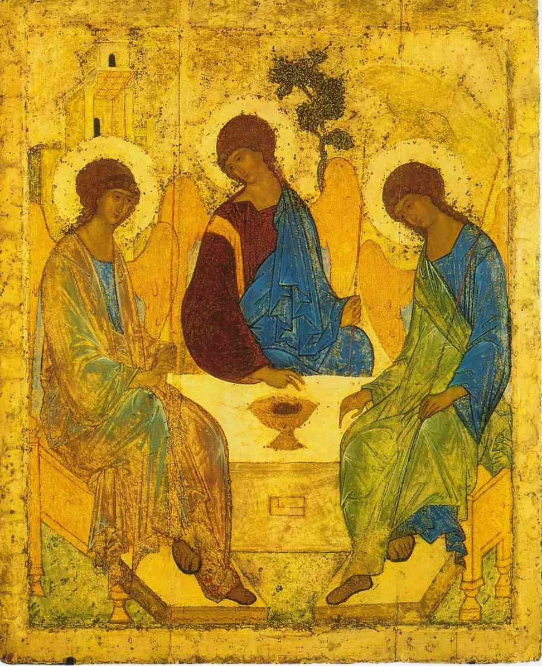
DF :
Decrease of Fidelity
a contemplative device
Notes:
Many religions have so called “contemplative devices” – the objects of cogitation that offer a unique perspective into nature of reality.
Trinity as a contemplative device was developed in Christianity in late 4th century A.D. and widely practice thereafter.
Buddhist had many contemplative devices, one of which is “Nirvana is the sound of the clap one hand makes”
Through attempting to understand these paradoxical statements one could get raptured into transcendence and gain a deeper understanding of reality.
Modern scientists, have similar devices. Consider particle/wave dualism in description of the nature of light or the notion that one atom can contain all the information about the universe.
There is such contemplative device is statistical modeling – degrees of freedom.

Slide 2
Degrees of Freedom = Decrease of Fidelity
Explaining modeling through defining DF

Slide 3
previously…
Teaching Students How to Spend Statistical Money to Purchase Effective Behavioral Models: Degrees-of-Freedom and Goodness-of-Fit as the Foundation of Psychological Science
Joseph Lee Rodgers
Lunch Bunch, Nov 17, 2011
Fisher Space
Variable Space
X1 X2
3 5
2 2
6
5
6
7
5
8
7
4 3
Notes:
Joe [Rodgers] spoke of representing data in variable-space and so called, Fisher-space which underlie the statistical thinking of R.A.Fisher
Variable space is the space we are most familiar with. This space places each variable in a separate dimension. This space is useful in describing how subjects differ in respect to variables.
Fisher space, on the other hand, places each subject in a its own dimension. This space is useful in describing how variables differ in respect to subjects.
Thus, a variable in a sample is a n-th dimensional projection into reality observed by the sample of size n.
Why is this more convenient? It’s easier to compare 2 things than 10 (N) things.
Reality is multidimensional, or consists of many perspectives.
However, the multiple dimensionality of fisher space is awkward and inconvenient, and that’s why we build models – to simplify descriptions of reality, to make them usable by our minds.
Degrees of freedom were conceptualized as reduction in dimensionality of Fisher space.
Today, I would like to show that Fisher Space is not difficult to conceptualize and offers a (hopefully) easier understanding of the modeling process. But even if this way of conceptualizing modeling is not “easier” on the face value, thinking about the same thing from different perspectives deepens our understanding of it.

Slide 4
Teaching Students How to Spend Statistical Money to Purchase Effective Behavioral Models: Degrees-of-Freedom and Goodness-of-Fit as the Foundation of Psychological Science
Joseph Lee Rodgers
Lunch Bunch, Nov 17, 2011
Degrees of Freedom
1) piece of information.
2) a piece of statistical money, which can be spent or saved
3) The number of df's spent estimating a model is (one) measure of complexity.
Notes:
Joe also mentioned other “ways of thinking” about degrees of freedom.
We find it useful to conceptualize the trade-off between fit and degrees of freedom in the allegory of a “purchase”
We say that : We “buy” the accuracy of the model “with” degrees of freedom. We “spend” degrees of freedom.
But I would like you to think about degrees of freedom as what were are after, what we are trying to buy, something that we want to have more of, the “object of desire”. And we pay for this “object” by incurring error. The more the error, the more dearly we pay.
This presentation is the attempt to contribute this line of thinking and to respond to and elaborate on Joe Rodgers’s talk.

Slide 5
Understanding DF
Do we ask the right question?
Irresistible Assumptions:
Terms must be self-explanatory
The name should suggest the “best” way of understanding the concept
If the term “Degrees of Freedom” were misleading the scientific community would have surely correct it
What is
“Degrees of Freedom”?
Why is it called
“Degrees of Freedom”?
VS.
Notes:
In stead of obsessing about the question “what IS” is, we better focus on “what does it do”?

Slide 6
Understanding DF
What is
“Degrees of Freedom”?
Why is it called
“Degrees of Freedom”?
VS.
Df = N - par
?
# independent points
dimensionality
Not important
Notes:
Does the words of the term determine how we think about it and what we expect it would describe?
Let’s not try to explain the name, let’s look at what it describes, and perhaps we could find a better name for the concept that guided students towards quicker and more solid understanding of this concept.
None of the answers have necessarily anything to do with “degrees” or “freedom”

Slide 7
Understanding DF
Perspective: DF talks about some completed process.
Therefore, meaningless outside the context of this process.
Consider:
Study | DF | N | Par
A | 40 | 42 | 2
B | 40 | 50 | 10
C | 40 | 80 | 40
Notes:
I want to look at DF as evaluation of certain change, a certain transformation
The meaning of DF is relative to the change it describes.
In study A we took 42 pieces of information and changed it into 2. DF=40 tells us something about this change.
Study A – Regression with two parameters
Study B – Two by five ANOVA
Study C – Multilevel dyad intercept only model.

Slide 8
The Process behind DF
What change are we talking about?
What process/event does DF evaluate?
Simplification of Reality
Specifically:
Simplification of the description of Reality
Notes:
Don’t ask “What is DF?” but ask “What HAPPENED that DF describes?”
What do we mean by “We gained a degree of freedom”? Itsn’t it the difference between something and something else? In that case we are talking about the same units that those “something” and “something else” were measuring.
“This simplification decreases the fidelity of our description by 14 degrees”

Slide 9
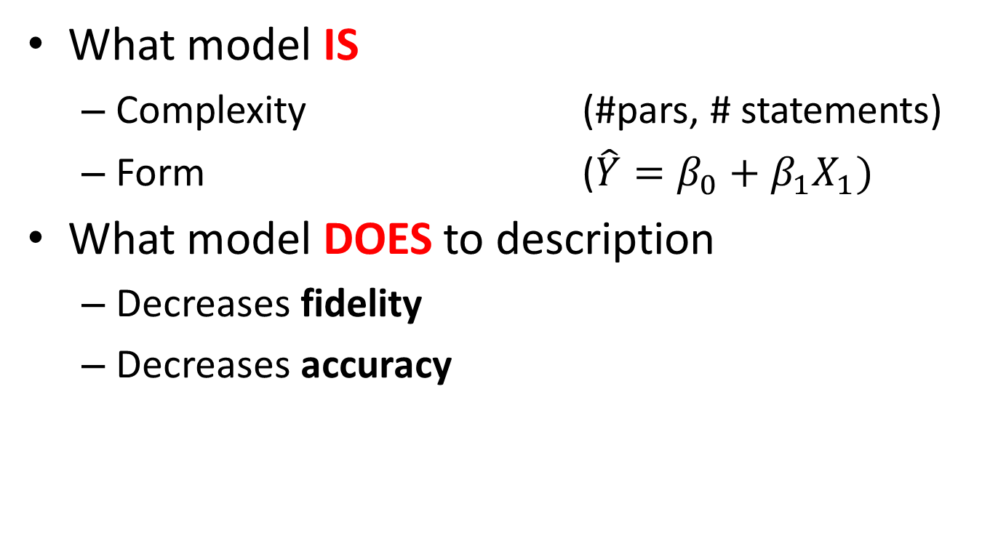
Model = simplifies description of reality
What model IS
Complexity (#pars, # statements)
Form ($\hat{Y}=β_{0}+β_{1}X_{1})$
What model DOES to description
Decreases fidelity
Decreases accuracy
Model takes a simplified copy of the description.
Notes:
Complexity – number of components, parameters, that model uses in producing the simplified description.
Form – how these components interact to provide a guess about the value of the criterion. Equation.
Models simplify descriptions. That’s what they do. To simplify is to decrease the number of statements in the description. To reduce dimensionality of the variable projection into n^{th} dimensional Fisher-Space.
What model does to description = is the properties of the description of reality as given by the model.

Slide 10
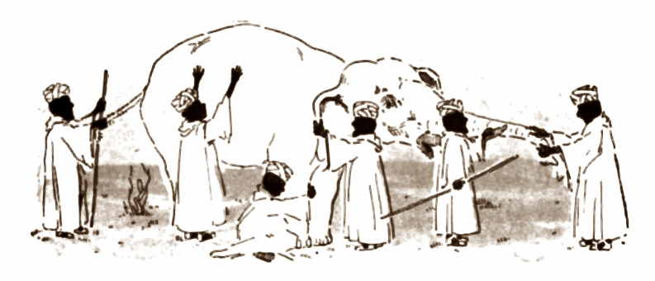
How many blind men were there?
X1 X2
3 5
2 2
6
5
6
7
5
8
7
4 3
description
statement
statement
statement
statement
statement
statement
Notes:
To ask “What the dimensionality of variable projection into fisher-space?” is to ask “How many blind men were there?” That is, to ask from how many independent points of view the reality has been observed.
It’s useful to think in Fisher-Space because one variable represents one description of reality.
Blind men tell us what they observe about reality. Blind men don’t talk among each other– their observations are independent, therefore statements exist in their own dimensions.
The report of each is a statement about reality ( a piece of info)
Six blind men give us a 6-dimensional description of reality in respect to the variable (Elephant)
we call a collection of statements about reality a DESCRIPTION of reality. A set of reports from independent observes of reality we call a DESCRIPTION of reality
Description consists of individual statements (to yourself: data points).
Many statements will describe the reality with HI FIDELITY, the fewer the statements the lower the fidelity.
We define COMPLEXITY of description to be the number of statements that comprise it.
The less complex description are easiest to grasp and decide.
When we simplify a description of reality to suit our needs we reduce the complexity of the description, using fewer statements to describe it.

Slide 11
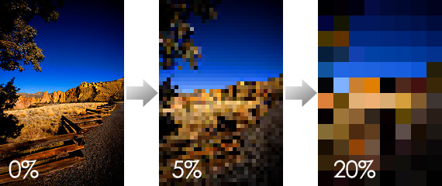
Decrease of Fidelity
Change in the number of independent statements
Change in the number of pixels
19960 pixels
1248 pixels
DF = 1168
80 pixels
Original
Exact Copy
Full Fidelity
Simplification₁
Simplification₂
Photo by pinklimoncello.
Notes:
(Image) Degree of Pixilation
how fine of a resolution do you want to have in our description
It might not make sense to make the picture of reality more fuzzy and ambiguous,
But in determining whether reality is generally blue or generally brown, this simplification could be quite useful.
Especially when he-res images of reality is inconvenient or not available to us
We want our model to have the highest fidelity and the lowest complexity.
When we loose it, we call it Fidelity.
When we talk about how fully we describe reality we’ll call the number of statements – Fidelity.
DF=14, the model made 14 less statements than the Full Fidelity description of reality.
DF = how many fewer individuals statements about reality our simplification has.
The change in the number of statements to describe the same reality we’ll call a fidelity change, decrease of fidelity.

Slide 12
Fidelity vs. Accuracy
Description
Bob is 175 cm tall
Mark is 184 cm tall
Joe is 181 cm tall
DF = 0
SS = 0
Model = exact copy
Bob is 175 cm tall
Mark is 184 cm tall
Joe is 181 cm tall
Model
Notes:
No decrease in fidelity, but decrease in accuracy

Slide 13
Fidelity vs. Accuracy
Description
Bob is 175 cm tall
Mark is 184 cm tall
Joe is 181 cm tall
DF = 0
SS = 5²+4²+1² = 42
Bob is 179 cm tall
Mark is 189 cm tall
Joe is 182 cm tall
Model
Notes:
No decrease in fidelity, but decrease in accuracy

Slide 14
Fidelity vs. Accuracy
Description
Bob is 175 cm tall
Mark is 184 cm tall
Joe is 181 cm tall
DF = 2
SS = 5²+4²+1² = 42
Guys are 180 cm tall
Model
Notes:
Decrease in fidelity and decrease in accuracy
Description gave you reality in 3 dimensions, but you collapsed it into a single dimension in your model.
So model is how many dimensions you allow in your simplification, and how you direct the projections from higher dimensions into them.

Slide 15


Model Comparison
fidelity
accuracy
I will describe this reality in 1 statement!
I will describe this reality in 3 statements!
DF = 14
DF = 12
Reduced H₀
Full
H₁
$$\hat{Y}=β_{0}$$
N=15
$$\hat{Y}=β_{0}+β_{1}X_{1}+β_{2}X_{2}$$
Notes:
So when evaluating rival models we have to understand what they DO to the description of the same reality, in terms of FIDELITY and ACCURACY.
To compare models is to see how fidelity and accuracy relate to each other in each simplification. By nesting models we arrive at rigorous comparison.
The more the model simplifies, the greater the decrease of fidelity (in degrees).
You can think of DF as the amount of work that the model performs, the more, the more work the model does, the better the model is. It simplifies THIS MUCH.
Accuracy, on the other hand could be measured a sum of squared discrepancies between corresponding coordinates.

Slide 16
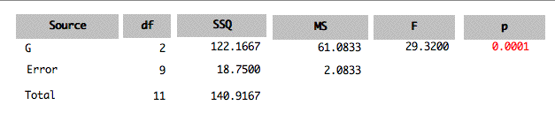
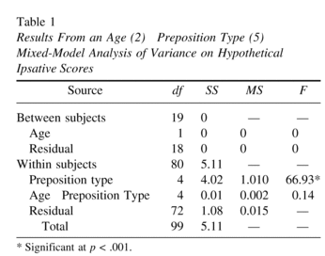
Traditional way to keep track of changes in fidelity and accuracy
Notes:
Rodger’s Slide
My comment: This supposed to be an “accounting of modeling” easier, this is a tool to keep track of simplifications, to compare them.
The goal of this talk : to present a new way of thinking about degrees of freedom (visual accounting)
This is an actuarial tool created to keep track of the Fisher Space as it undergoes reduction of complexity under the instruction of the model we test.

Slide 17
Today
New way to think about DF as Decrease of Fidelity
Model comparison with new vocabulary
Visual accounting system for model comparison
Notes:
So in some way, this is not theoretical innovation, but merely a managerial project.

Slide 18
The Process Behind DF
simplifying the description of reality
Measurement Theory
Modeling
I.
II.
Reality
Description of Reality
Simplified
Notes:
DF tells us something about what happened when we took a description of reality and CHANGED it somehow to better suit our needs ( clarity, particular question, etc).
So first, scientist must DESCRIBE reality in some way, and then make this description meaningful. It’s a two-stage process.

Slide 19
Description of Reality
Simplified
Notes:
So first, scientist must DESCRIBE reality in some way, and then make this description meaningful. It’s a two-stage process.

Slide 20
Triathlon Study
Description of Reality
Preparing for Triathlon - What shoes to buy?
Three type of shoes
Which type is easier to put on?
Easier = Faster in seconds
Let‘s ask some people to put on shoes and describe the reality
Nike | Reebok | Adidas
12 | 10 | 8
9 | 8 | 7
8 | 5 | 5
7 | 4 | 3
4 | 3 | 2
Describing the reality we witnessed:
Methods +
Subject #1 tied Nike shoe in 8 seconds
Subject #2 tied Nike shoe in 4 seconds
Subject #3 tied Nike shoe A in 7 seconds
…
Notes:
The (even more detailed) description in the Methods section references to the reality that was common for all the observations, so no need to repeat for all. Although, those would be the most accurate depiction of reality.

Slide 21
Hypothetical Study
Description of Reality
Verbal
Subject #1 tied Nike shoe in 8 seconds
Subject #2 tied Nike shoe in 12 seconds
Subject #3 tied Nike shoe in 4 seconds
Subject #4 tied Nike shoe in 9 seconds
Subject #5 tied Nike shoe in 7 seconds
Subject #1 tied Reebok shoe in 3 seconds
Subject #2 tied Reebok shoe in 8 seconds
Subject #3 tied Reebok shoe in 10 seconds
Subject #4 tied Reebok shoe in 4 seconds
Subject #5 tied Reebok shoe in 5 seconds
Subject #1 tied Adidas shoe in 8 seconds
Subject #2 tied Adidas shoe in 7 seconds
Subject #3 tied Adidas shoe in 3 seconds
Subject #4 tied Adidas shoe in 2 seconds
Subject #5 tied Adidas shoe in 5 seconds
Notes:
This is the most precise description of reality possible.
Each line represents an individual statement about reality.
There are 15 statements about reality that we made in this description.
Let see if we can present the same 15 statements in a way that eases our perception

Slide 22
Hypothetical Study
Description of Reality
Subject #1 tied Nike shoe in 8 seconds
Subject #2 tied Nike shoe in 12 seconds
Subject #3 tied Nike shoe in 4 seconds
Subject #4 tied Nike shoe in 9 seconds
Subject #5 tied Nike shoe in 7 seconds
Subject #1 tied Reebok shoe in 3 seconds
Subject #2 tied Reebok shoe in 8 seconds
Subject #3 tied Reebok shoe in 10 seconds
Subject #4 tied Reebok shoe in 4 seconds
Subject #5 tied Reebok shoe in 5 seconds
Subject #1 tied Adidas shoe in 8 seconds
Subject #2 tied Adidas shoe in 7 seconds
Subject #3 tied Adidas shoe in 3 seconds
Subject #4 tied Adidas shoe in 2 seconds
Subject #5 tied Adidas shoe in 5 seconds
Notes:
We are not changing the informational content, we merely changing the ease of perception. But the statements carry the same information.

Slide 23
Hypothetical Study
Description of Reality
Subject #1 tied Nike shoe in 8 seconds
Subject #2 tied Nike shoe in 12 seconds
Subject #3 tied Nike shoe in 4 seconds
Subject #4 tied Nike shoe in 9 seconds
Subject #5 tied Nike shoe in 7 seconds
Subject #1 tied Reebok shoe in 3 seconds
Subject #2 tied Reebok shoe in 8 seconds
Subject #3 tied Reebok shoe in 10 seconds
Subject #4 tied Reebok shoe in 4 seconds
Subject #5 tied Reebok shoe in 5 seconds
Subject #1 tied Adidas shoe in 8 seconds
Subject #2 tied Adidas shoe in 7 seconds
Subject #3 tied Adidas shoe in 3 seconds
Subject #4 tied Adidas shoe in 2 seconds
Subject #5 tied Adidas shoe in 5 seconds
Notes:
Transitional Slide

Slide 24





Hypothetical Study
Description of Reality
1
Subject #1 tied Nike shoe in 8 seconds
Subject #2 tied Nike shoe in 12 seconds
Subject #3 tied Nike shoe in 4 seconds
Subject #4 tied Nike shoe in 9 seconds
Subject #5 tied Nike shoe in 7 seconds
Subject #1 tied Reebok shoe in 3 seconds
Subject #2 tied Reebok shoe in 8 seconds
Subject #3 tied Reebok shoe in 10 seconds
Subject #4 tied Reebok shoe in 4 seconds
Subject #5 tied Reebok shoe in 5 seconds
Subject #1 tied Adidas shoe in 8 seconds
Subject #2 tied Adidas shoe in 7 seconds
Subject #3 tied Adidas shoe in 3 seconds
Subject #4 tied Adidas shoe in 2 seconds
Subject #5 tied Adidas shoe in 5 seconds
2
3
4
5
Notes:
Transitional Slide

Slide 25
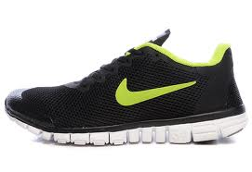
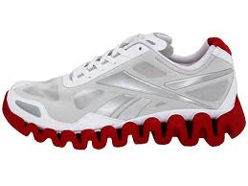
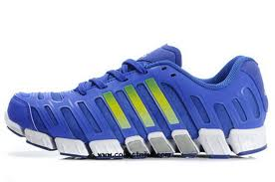
Hypothetical Study
Description of Reality
Nike
Reebok
Adidas
1
Subject #1 tied Nike shoe in 8 seconds
Subject #2 tied Nike shoe in 12 seconds
Subject #3 tied Nike shoe in 4 seconds
Subject #4 tied Nike shoe in 9 seconds
Subject #5 tied Nike shoe in 7 seconds
Subject #1 tied Reebok shoe in 3 seconds
Subject #2 tied Reebok shoe in 8 seconds
Subject #3 tied Reebok shoe in 10 seconds
Subject #4 tied Reebok shoe in 4 seconds
Subject #5 tied Reebok shoe in 5 seconds
Subject #1 tied Adidas shoe in 8 seconds
Subject #2 tied Adidas shoe in 7 seconds
Subject #3 tied Adidas shoe in 3 seconds
Subject #4 tied Adidas shoe in 2 seconds
Subject #5 tied Adidas shoe in 5 seconds
2
3
4
5
Notes:
Transitional Slide

Slide 26
Hypothetical Study
Description of Reality
Nike
Reebok
Adidas
1
12
10
8
2
9
8
7
3
8
5
5
4
7
4
3
5
4
3
2

Slide 27
Description of Reality
Verbal
Numeric
Subject #1 tied Nike shoe in 8 seconds
Subject #2 tied Nike shoe in 4 seconds
Subject #3 tied Nike shoe A in 7 seconds
Subject #4 tied Nike shoe A in 5 seconds
Subject #5 tied Nike shoe in 6 seconds
Subject #1 tied Reebok shoe in 8 seconds
Subject #2 tied Reebok shoe in 4 seconds
Subject #3 tied Reebok shoe A in 7 seconds
Subject #4 tied Reebok shoe A in 5 seconds
Subject #5 tied Reebok shoe in 6 seconds
Subject #1 tied Adidas shoe in 8 seconds
Subject #2 tied Adidas shoe in 4 seconds
Subject #3 tied Adidas shoe A in 7 seconds
Subject #4 tied Adidas shoe A in 5 seconds
Subject #5 tied Adidas shoe in 6 seconds
Sub | N | R | A
1 | 12 | 10 | 8
2 | 9 | 8 | 7
3 | 8 | 5 | 5
4 | 7 | 4 | 3
5 | 4 | 3 | 2
Notes:
Notice that we still depict the same 15 units of information.
We preserved only the relevant information, encoding info that pertains to ALL our subjects into representational conventions and rules.

Slide 28
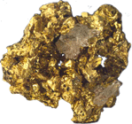
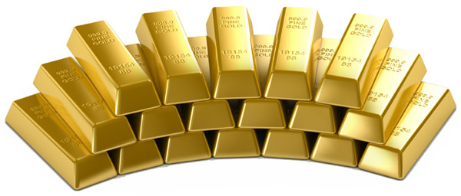
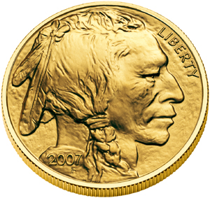
Description of Reality
Verbal
Numeric
Graphic
Subject #1 tied Nike shoe in 8 seconds
Subject #2 tied Nike shoe in 4 seconds
Subject #3 tied Nike shoe A in 7 seconds
Subject #4 tied Nike shoe A in 5 seconds
Subject #5 tied Nike shoe in 6 seconds
Subject #1 tied Reebok shoe in 8 seconds
Subject #2 tied Reebok shoe in 4 seconds
Subject #3 tied Reebok shoe A in 7 seconds
Subject #4 tied Reebok shoe A in 5 seconds
Subject #5 tied Reebok shoe in 6 seconds
Subject #1 tied Adidas shoe in 8 seconds
Subject #2 tied Adidas shoe in 4 seconds
Subject #3 tied Adidas shoe A in 7 seconds
Subject #4 tied Adidas shoe A in 5 seconds
Subject #5 tied Adidas shoe in 6 seconds
Sub | N | R | A
1 | 12 | 10 | 8
2 | 9 | 8 | 7
3 | 8 | 5 | 5
4 | 7 | 4 | 3
5 | 4 | 3 | 2
10
5
The amount of information in all three expressions is IDENTICAL.
We used the same number of statements to describe the same reality
Notes:
If we adopt yet other representational conventions we can depict the same 15 pieces of information graphically.
We will measure information in STATEMENTS about reality.
The more statements you have about reality the more information you possess.
Each of these expressions have different values according to the different purposes.
But notice that we apply more and more creativity from left to right.
Practicing Christians should understand this concept better than others ☺

Slide 29
Description of Reality
Verbal
Numeric
Graphic
Subject #1 tied Nike shoe in 8 seconds
Subject #2 tied Nike shoe in 4 seconds
Subject #3 tied Nike shoe A in 7 seconds
Subject #4 tied Nike shoe A in 5 seconds
Subject #5 tied Nike shoe in 6 seconds
Subject #1 tied Reebok shoe in 8 seconds
Subject #2 tied Reebok shoe in 4 seconds
Subject #3 tied Reebok shoe A in 7 seconds
Subject #4 tied Reebok shoe A in 5 seconds
Subject #5 tied Reebok shoe in 6 seconds
Subject #1 tied Adidas shoe in 8 seconds
Subject #2 tied Adidas shoe in 4 seconds
Subject #3 tied Adidas shoe A in 7 seconds
Subject #4 tied Adidas shoe A in 5 seconds
Subject #5 tied Adidas shoe in 6 seconds
10
Sub | N | R | A
1 | 12 | 10 | 8
2 | 9 | 8 | 7
3 | 8 | 5 | 5
4 | 7 | 4 | 3
5 | 4 | 3 | 2
5
N R A
?
?
?
Simplified
Notes:
These three sets of 15 statements about witnessed reality are equivalent.
It implies that having access to one of them, we are capable of recreating the other two provided we know the rules and conventions of transformations (notation)
To do any sort of reasoning with these statements to see whether they affirm or disproves our hypotheses, we want to keep the number of statements of reasonable size.
To “describe” means to relay the essence. There can’t be objective description. Moreover, when we make a copy of a description, we suit the accuracy of this copy (fidelity) to our research needs. By simplifying, copying the original of the reality we are capturing the essence as we see it and leaving out the cluttering details that rival for our attention.

Slide 30
Description of Reality
Graphic
Verbal
Time
Numeric
Subject #1 tied Nike shoe in 8 seconds
Subject #2 tied Nike shoe in 4 seconds
Subject #3 tied Nike shoe A in 7 seconds
Subject #4 tied Nike shoe A in 5 seconds
Subject #5 tied Nike shoe in 6 seconds
Subject #1 tied Reebok shoe in 8 seconds
Subject #2 tied Reebok shoe in 4 seconds
Subject #3 tied Reebok shoe A in 7 seconds
Subject #4 tied Reebok shoe A in 5 seconds
Subject #5 tied Reebok shoe in 6 seconds
Subject #1 tied Adidas shoe in 8 seconds
Subject #2 tied Adidas shoe in 4 seconds
Subject #3 tied Adidas shoe A in 7 seconds
Subject #4 tied Adidas shoe A in 5 seconds
Subject #5 tied Adidas shoe in 6 seconds
10
Sub | N | R | A
1 | 12 | 10 | 8
2 | 9 | 8 | 7
3 | 8 | 5 | 5
4 | 7 | 4 | 3
5 | 4 | 3 | 2
5
N R A
A
10
5
N R A
Simplified
Notes:
(NO VERTICAL CORRESPONDENCE)
If we can find a simpler expression of reality in one(Graphic, for example) , we KNOW that there exist representations the other two ( Verbal, Numeric)
Let’s find a simpler way to represent the same information graphically
Add (C)
Fair question to ask, does it even talk about the same reality?
is much better representation that (A) or (B). This proves that some representations would be bad one, and some would be good.
This implies that we can measure and compare any two of them using an objective criteria, and based on that criteria choose in favor of one of them, as the more
But even the “best” of possible representation might not cut it. We can compute the “best” but weather it’s an accurate representation of reality is a tougher choice.
Perhaps, I could make you say “Yeah, but….” now it becomes the question of how big of a “but” it is. The claim with the smallest “but” wins.

Slide 31
Description of Reality
Graphic
Verbal
Time
Numeric
Subject #1 tied Nike shoe in 8 seconds
Subject #2 tied Nike shoe in 4 seconds
Subject #3 tied Nike shoe A in 7 seconds
Subject #4 tied Nike shoe A in 5 seconds
Subject #5 tied Nike shoe in 6 seconds
Subject #1 tied Reebok shoe in 8 seconds
Subject #2 tied Reebok shoe in 4 seconds
Subject #3 tied Reebok shoe A in 7 seconds
Subject #4 tied Reebok shoe A in 5 seconds
Subject #5 tied Reebok shoe in 6 seconds
Subject #1 tied Adidas shoe in 8 seconds
Subject #2 tied Adidas shoe in 4 seconds
Subject #3 tied Adidas shoe A in 7 seconds
Subject #4 tied Adidas shoe A in 5 seconds
Subject #5 tied Adidas shoe in 6 seconds
10
Sub | N | R | A
1 | 12 | 10 | 8
2 | 9 | 8 | 7
3 | 8 | 5 | 5
4 | 7 | 4 | 3
5 | 4 | 3 | 2
5
N R A
B
10
5
N R A
Simplified
Notes:
(NO VERTICAL CORRESPONDENCE)
If we can find a simpler expression of reality in one(Graphic, for example) , we KNOW that there exist representations the other two ( Verbal, Numeric)
Let’s find a simpler way to represent the same information graphically
Add (C)
Fair question to ask, does it even talk about the same reality?
is much better representation that (A) or (B). This proves that some representations would be bad one, and some would be good.
This implies that we can measure and compare any two of them using an objective criteria, and based on that criteria choose in favor of one of them, as the more
But even the “best” of possible representation might not cut it. We can compute the “best” but weather it’s an accurate representation of reality is a tougher choice.
Perhaps, I could make you say “Yeah, but….” now it becomes the question of how big of a “but” it is. The claim with the smallest “but” wins.

Slide 32
Description of Reality
Graphic
Verbal
Time
Numeric
Subject #1 tied Nike shoe in 8 seconds
Subject #2 tied Nike shoe in 4 seconds
Subject #3 tied Nike shoe A in 7 seconds
Subject #4 tied Nike shoe A in 5 seconds
Subject #5 tied Nike shoe in 6 seconds
Subject #1 tied Reebok shoe in 8 seconds
Subject #2 tied Reebok shoe in 4 seconds
Subject #3 tied Reebok shoe A in 7 seconds
Subject #4 tied Reebok shoe A in 5 seconds
Subject #5 tied Reebok shoe in 6 seconds
Subject #1 tied Adidas shoe in 8 seconds
Subject #2 tied Adidas shoe in 4 seconds
Subject #3 tied Adidas shoe A in 7 seconds
Subject #4 tied Adidas shoe A in 5 seconds
Subject #5 tied Adidas shoe in 6 seconds
10
Sub | N | R | A
1 | 12 | 10 | 8
2 | 9 | 8 | 7
3 | 8 | 5 | 5
4 | 7 | 4 | 3
5 | 4 | 3 | 2
5
N R A
C
10
5
N R A
Simplified
Notes:
(NO VERTICAL CORRESPONDENCE)
If we can find a simpler expression of reality in one(Graphic, for example) , we KNOW that there exist representations the other two ( Verbal, Numeric)
Let’s find a simpler way to represent the same information graphically
Add (C)
Fair question to ask, does it even talk about the same reality?
is much better representation that (A) or (B). This proves that some representations would be bad one, and some would be good.
This implies that we can measure and compare any two of them using an objective criteria, and based on that criteria choose in favor of one of them, as the more
But even the “best” of possible representation might not cut it. We can compute the “best” but weather it’s an accurate representation of reality is a tougher choice.
Perhaps, I could make you say “Yeah, but….” now it becomes the question of how big of a “but” it is. The claim with the smallest “but” wins.

Slide 33
Description of Reality
Graphic
Verbal
Time
Numeric
Subject #1 tied Nike shoe in 8 seconds
Subject #2 tied Nike shoe in 4 seconds
Subject #3 tied Nike shoe A in 7 seconds
Subject #4 tied Nike shoe A in 5 seconds
Subject #5 tied Nike shoe in 6 seconds
Subject #1 tied Reebok shoe in 8 seconds
Subject #2 tied Reebok shoe in 4 seconds
Subject #3 tied Reebok shoe A in 7 seconds
Subject #4 tied Reebok shoe A in 5 seconds
Subject #5 tied Reebok shoe in 6 seconds
Subject #1 tied Adidas shoe in 8 seconds
Subject #2 tied Adidas shoe in 4 seconds
Subject #3 tied Adidas shoe A in 7 seconds
Subject #4 tied Adidas shoe A in 5 seconds
Subject #5 tied Adidas shoe in 6 seconds
10
Sub | N | R | A
1 | 12 | 10 | 8
2 | 9 | 8 | 7
3 | 8 | 5 | 5
4 | 7 | 4 | 3
5 | 4 | 3 | 2
5
N R A
Subjects tied Nike shoes in 8 seconds
Subjects tied Reebok shoes in 6 seconds
Subjects tied Adidas shoes in 5 seconds
10
Sub | N | R | A
1 | 8 | 6 | 5
2
3
4
5
5
N R A
Simplified
Notes:
We showed that graphic simplification is a reasonable simplification that does justice to the reality, albeit not without a certain distortion of it.
The equivalence of Graphic Simplified (S) and Numeric (S) has also been demonstrated. We simply applied the representational convention from the top part.
Hence if 1) Graphic (S) is a simpler ( and reasonable) version of Graphic and 2) Numeric(S) is equivalent to Graphic (S) it logically follows that 3) Numeric(S) is a reasonable simplification of Unsimplified Numeric depiction of reality.

Slide 34
Description of Reality
Graphic
Verbal
Time
Numeric
Subject #1 tied Nike shoe in 8 seconds
Subject #2 tied Nike shoe in 4 seconds
Subject #3 tied Nike shoe A in 7 seconds
Subject #4 tied Nike shoe A in 5 seconds
Subject #5 tied Nike shoe in 6 seconds
Subject #1 tied Reebok shoe in 8 seconds
Subject #2 tied Reebok shoe in 4 seconds
Subject #3 tied Reebok shoe A in 7 seconds
Subject #4 tied Reebok shoe A in 5 seconds
Subject #5 tied Reebok shoe in 6 seconds
Subject #1 tied Adidas shoe in 8 seconds
Subject #2 tied Adidas shoe in 4 seconds
Subject #3 tied Adidas shoe A in 7 seconds
Subject #4 tied Adidas shoe A in 5 seconds
Subject #5 tied Adidas shoe in 6 seconds
10
Sub | N | R | A
1 | 12 | 10 | 8
2 | 9 | 8 | 7
3 | 8 | 5 | 5
4 | 7 | 4 | 3
5 | 4 | 3 | 2
5
15
DF = 12
3
Subjects tied Nike shoes in 8 seconds
Subjects tied Reebok shoes in 6 seconds
Subjects tied Adidas shoes in 5 seconds
10
Sub | N | R | A
1 | 8 | 6 | 5
2
3
4
5
5
N R A
Simplified
Notes:
In this particular case…

Slide 35
Description of Reality
Graphic
Verbal
Time
Numeric
Subject #1 tied Nike shoe in 8 seconds
Subject #2 tied Nike shoe in 4 seconds
Subject #3 tied Nike shoe A in 7 seconds
Subject #4 tied Nike shoe A in 5 seconds
Subject #5 tied Nike shoe in 6 seconds
Subject #1 tied Reebok shoe in 8 seconds
Subject #2 tied Reebok shoe in 4 seconds
Subject #3 tied Reebok shoe A in 7 seconds
Subject #4 tied Reebok shoe A in 5 seconds
Subject #5 tied Reebok shoe in 6 seconds
Subject #1 tied Adidas shoe in 8 seconds
Subject #2 tied Adidas shoe in 4 seconds
Subject #3 tied Adidas shoe A in 7 seconds
Subject #4 tied Adidas shoe A in 5 seconds
Subject #5 tied Adidas shoe in 6 seconds
10
Sub | N | R | A
1 | 12 | 10 | 8
2 | 9 | 8 | 7
3 | 8 | 5 | 5
4 | 7 | 4 | 3
5 | 4 | 3 | 2
5
15
DF = 14
1
10
Subjects tied shoes in 6.3 seconds
Sub | N | R | A
1 | 6.3
2
3
4
5
5
Simplified
Notes:
Back and forth slides: First

Slide 36
Description of Reality
Time
Time
10
10
5
5
15
15
DF = 12
DF = 14
3
1
10
10
5
5
Simplified
Notes:
Comparing Two simplification in terms of fidelity. Next we need to see what inaccuracy was associated with each of these simplifications. But first,
15-3 simplification also can be achieve by formulating a multiple regression with two predictors.

Slide 37
Time
Time
10
10
5
5
15
15
DF = 12
DF = 14
3
1
10
10
5
5
Notes:
Comparing Two simplification in terms of fidelity. Next we need to see what inaccuracy was associated with each of these simplifications. But first,
15-3 simplification also can be achieve by formulating a multiple regression with two predictors.

Slide 38
15
15
DF = 12
DF = 14
3
1
Notes:
We can imagine a different kind of simplification, and on a different variable (property). For instance their age might influence how fast they tie the shoe.
Fidelity – the number of independent statements that describe reality. Notice, I say nothing of accuracy. Accuracy is a different property of a simplification. Comparing change of rate

Slide 39
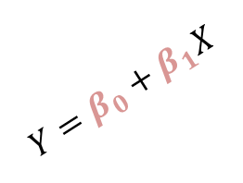
Time
10
5
Age
15
15
15
DF = 12
DF = 13
DF = 14
3
2
1
10
$$Y=β_{0}+β_{1}X$$
5
Notes:
We can think of a way to simplify the reality with respect to VARIABLE Experience: y= a + bx
A model that represented 15 statements about reality as 2 statements, reduced the fidelity of the statement by 13 degrees, and accumulated SSE inaccuracy.

Slide 40
15
15
15
15
15
15
15
15
15
15
15
15
15
15
15
0
1
2
3
4
5
6
7
8
9
10
11
12
13
14
15
14
13
12
11
10
9
8
7
6
5
4
3
2
1
Notes:
We can imagine a continuum of such simplifications
It can be a nested continuum. Or it could be composed of non-unique simplification with the same loss of fidelity.
For every simplification, we make a copy of reality. We choose what features are of interest and simplify in respect to them. In the process of we lose fidelity of that description. The notion of degrees of (lost) fidelity, quantifies the process of simplification.
There are total of 15 degrees of fidelity in this case. One degree is one observation of reality. The more observations we have, the “truer” the picture of reality, the greater the fidelity of our description of it. Ever degree, every data element is the evidence that supports our claim is true ( has fidelity), the greater the fidelity, the more substantiated and “true” the claim is.

Slide 41
Decrease of fidelity = amount of simplifying/work performed by the model
0
1
2
3
4
5
6
7
8
9
10
11
12
13
14
15
14
13
12
11
10
9
8
7
6
5
4
3
2
1
Complexity of the model = number of independent statements in description
Notes:
We can imagine a continuum of such simplifications
It can be a nested continuum. Or it could be composed of non-unique simplification with the same loss of fidelity.
For every simplification, we make a copy of reality. We choose what features are of interest and simplify in respect to them. In the process of we lose fidelity of that description. The notion of degrees of (lost) fidelity, quantifies the process of simplification.
There are total of 15 degrees of fidelity in this case. One degree is one observation of reality. The more observations we have, the “truer” the picture of reality, the greater the fidelity of our description of it. Ever degree, every data element is the evidence that supports our claim is true ( has fidelity), the greater the fidelity, the more substantiated and “true” the claim is.

Slide 42
Decrease of fidelity = amount of simplifying/work performed by the model
A model
15
15
15
15
15
15
15
15
15
15
15
15
15
15
15
0
1
2
3
4
5
6
7
8
9
10
11
12
13
14
15
14
13
12
11
10
9
8
7
6
5
4
3
2
1
Complexity of the model = number of independent statements in description

Slide 43
15
15
15
15
15
15
15
15
15
15
15
15
15
15
15
0
1
2
3
4
5
6
7
8
9
10
11
12
13
14
15
14
13
12
11
10
9
8
7
6
5
4
3
2
1
Decrease of Fidelity
Complexity
10
5
Notes:
We measure parsimony in DF, so it is inaccuracy to equate parsimony to model complexity, they are inverse notions.

Slide 44
15
15
15
15
15
15
15
15
15
15
15
15
15
15
15
0
1
2
3
4
5
6
7
8
9
10
11
12
13
14
15
14
13
12
11
10
9
8
7
6
5
4
3
2
1
DF
#pars
Work done
#statements

Slide 45
Decrease of fidelity = amount of simplifying/work performed by the model
0
1
2
3
4
5
6
7
8
9
10
11
12
13
14
Decrease of Accuracy
15
15
15
15
15
15
15
15
15
15
15
15
15
15
15
0
1
2
3
4
5
6
7
8
9
10
11
12
13
14
15
14
13
12
11
10
9
8
7
6
5
4
3
2
1
DF
#pars
Work done
#statements
15
14
13
12
11
10
9
8
7
6
5
4
3
2
1
Complexity of the model = number of independent statements in description

Slide 46
Decrease of fidelity = amount of simplifying/work performed by the model
0
1
2
3
4
5
6
7
8
9
10
11
12
13
14
Decrease of Accuracy
15
14
13
12
11
10
9
8
7
6
5
4
3
2
1
Complexity of the model = number of independent statements in description
Notes:
We can imagine a continuum of such simplifications
It can be a nested continuum. Or it could be composed of non-unique simplification with the same loss of fidelity.
For every simplification, we make a copy of reality. We choose what features are of interest and simplify in respect to them. In the process of we lose fidelity of that description. The notion of degrees of (lost) fidelity, quantifies the process of simplification.
There are total of 15 degrees of fidelity in this case. One degree is one observation of reality. The more observations we have, the “truer” the picture of reality, the greater the fidelity of our description of it. Ever degree, every data element is the evidence that supports our claim is true ( has fidelity), the greater the fidelity, the more substantiated and “true” the claim is.

Slide 47
Decrease of fidelity = amount of simplifying/work performed by the model
0
1
2
3
4
5
6
7
8
9
10
11
12
13
14
Usually compare only two simplifications
SSE
F evaluates
this difference
Decrease of Accuracy
4
SSR
4
15
14
13
12
11
10
9
8
7
6
5
4
3
2
1
Complexity of the model = number of independent statements in description
Notes:
We can imagine a continuum of such simplifications
It can be a nested continuum. Or it could be composed of non-unique simplification with the same loss of fidelity.
The null model (blue) assumes the constant rate of change for previous simplifications, calculates the average.
For every simplification, we make a copy of reality. We choose what features are of interest and simplify in respect to them. In the process of we lose fidelity of that description. The notion of degrees of (lost) fidelity, quantifies the process of simplification.
There are total of 15 degrees of fidelity in this case. One degree is one observation of reality. The more observations we have, the “truer” the picture of reality, the greater the fidelity of our description of it. Ever degree, every data element is the evidence that supports our claim is true ( has fidelity), the greater the fidelity, the more substantiated and “true” the claim is.

Slide 48
Decrease of fidelity = amount of simplifying/work performed by the model
0
1
2
3
4
5
6
7
8
9
10
11
12
13
14
15
14
13
12
11
10
9
8
7
6
5
4
3
2
1
Complexity of the model = number of independent statements in description
Notes:
When we make an exact copy of the reality our misrepresentation is NULL.

Slide 49
Decrease of fidelity = amount of simplifying/work performed by the model
0
1
2
3
4
5
6
7
8
9
10
11
12
13
14
Decrease of Accuracy
15
14
13
12
11
10
9
8
7
6
5
4
3
2
1
Complexity of the model = number of independent statements in description
Notes:
If we decide that these two scores are sufficiently similar and could be represented by a single value for our convenience, we are decreasing the fidelity of our description of reality by one degree of fidelity.
When fidelity is decreased the inaccuracy of representation increases. Less fidelity = more error.
We measure the loss in accuracy by the sum of squared differences between observed and simplified values, literally measuring the simplification.
The fidelity was decreased by 1 (degree), while Accuracy was decreased by (Area of the Square).
The cost of giving up 1 degree of fidelity is (Area of the Square)
It doesn’t seem to make much sense to simplify this reality like that, 15 to 14. However some simplification might be more useful than outhers. What kind of questions a particular simplification can answer is the domain of research design, which relies on quantitative evaluation of simplifications (hypotheses, models) to answer questions
What simplification possible next?

Slide 50
Decrease of fidelity = amount of simplifying/work performed by the model
0
1
2
3
4
5
6
7
8
9
10
11
12
13
14
Decrease of Accuracy
15
14
13
12
11
10
9
8
7
6
5
4
3
2
1
Complexity of the model = number of independent statements in description
Notes:
While, not every simplification would be sensible, we must recognize the existence of this simplification continuum.
Any simplification on this continuum would be possible, but not necessarily sensible.
But we know that if we make is more simple the “misfit”, error, inaccuracy would increase as well.

Slide 51
Decrease of fidelity = amount of simplifying/work performed by the model
0
1
2
3
4
5
6
7
8
9
10
11
12
13
14
Decrease of Accuracy
15
14
13
12
11
10
9
8
7
6
5
4
3
2
1
Complexity of the model = number of independent statements in description
Notes:
Fidelity was decreased by 3 (degrees), while the Inaccuracy increased by the Area of Square.
The cost of reducing the complexity of description by 3 degrees of fidelity is (Area of Square). Each degree cost MSR.

Slide 52
Decrease of fidelity = amount of simplifying/work performed by the model
0
1
2
3
4
5
6
7
8
9
10
11
12
13
14
Decrease of Accuracy
15
14
13
12
11
10
9
8
7
6
5
4
3
2
1
Complexity of the model = number of independent statements in description
Notes:
While, not every simplification would be sensible, we must recognize the existence of this simplification continuum.
Any simplification on this continuum would be possible, but not necessarily sensible.
But we know that if we make is more simple the “misfit”, error, inaccuracy would increase as well.

Slide 53
Decrease of fidelity = amount of simplifying/work performed by the model
0
1
2
3
4
5
6
7
8
9
10
11
12
13
14
Decrease of Accuracy
15
14
13
12
11
10
9
8
7
6
5
4
3
2
1
Complexity of the model = number of independent statements in description
Notes:
Here, one particular simplification would make sense.
Randomized Block Desing
Or
Multilevel Regression
Out of five degrees (units) of fidelity that we lost in this simplification, which one contributed the most to the loss of accuracy? Theoretically, we can find out. Buy the loss of accuracy varies too, so we use an average, average squared error incurred by a particular simplification.

Slide 54
Decrease of fidelity = amount of simplifying/work performed by the model
0
1
2
3
4
5
6
7
8
9
10
11
12
13
14
Reduced, H₀
SST
df_{T}
15
14
13
12
11
10
9
8
7
6
5
4
3
2
1
Complexity of the model = number of independent statements in description
Notes:
We took description with fidelity of 15, expressed it as 1 , incurred SST inaccuracy, and lost MST accuracy on average for 14 degrees of fidelity lost in simplification.

Slide 55
Decrease of fidelity = amount of simplifying/work performed by the model
0
1
2
3
4
5
6
7
8
9
10
11
12
13
14
1
117.3
MST
14
15
14
13
12
11
10
9
8
7
6
5
4
3
2
1
Complexity of the model = number of independent statements in description
Notes:
We took description with fidelity of 15, expressed it as 1 , incurred 117.3inaccuracy, and lost 8.3 accuracy on average for 14 degrees of fidelity lost in simplification.

Slide 56
Decrease of fidelity = amount of simplifying/work performed by the model
0
1
2
3
4
5
6
7
8
9
10
11
12
13
14
Full, H₁
MSE
df_{E}
SSE
15
14
13
12
11
10
9
8
7
6
5
4
3
2
1
Complexity of the model = number of independent statements in description

Slide 57
Decrease of fidelity = amount of simplifying/work performed by the model
0
1
2
3
4
5
6
7
8
9
10
11
12
13
14
3
7.8
12
94.0
15
14
13
12
11
10
9
8
7
6
5
4
3
2
1
Complexity of the model = number of independent statements in description

Slide 58
Reduced, H₀
SST
Full, H₁
df_{T}
df_{E}
SSE
Notes:
Any hypothesis testing or model evaluation would evolve comparing the values that describe this change in accuracy and fidelity.
In other words, our analysis of data comes down to analyzing and making sense from the difference of these two inaccuracies.
Let’s see how we can do that, and how degrees of fidelity help us make sense of it.

Slide 59
Reduced, H₀
SST
Full, H₁
SSR
df_{T}
df_{E}
SSE
Notes:
In attempt to make sense which simplification is better (accurate, simple) we compare change in inaccuracy to the change in fidelity.
We are determining the rate of change.

Slide 60
Reduced, H₀
SST
Full, H₁
SSR
PIE
PRE
df_{T}
df_{E}
SSE

Slide 61
1
117.3
3
23.3
25%
20%
14
12
94.0

Slide 62
Reduced, H₀
SST
Full, H₁
SSR
IC
PIE
PRE
df_{T}
DF
df_{E}
SSE
Notes:
IC – increase in complexity
DF – decrease in fidelity
Some of the info pieces would be more important than others in understanding this aspect of reality ( variable). Model development is a systematic way to remove non-crucial elements from the description of reality
DF_{T} shows how many degrees of fidelity was lost during simplification, SST shows how much it cost to simplify like this, measured in the units of accuracy (OLS)

Slide 63
1
117.3
3
23.3
2
25%
20%
11.7
14
2
12
94.0
Notes:
We can think of MSR in two ways:
The cost of having a simpler model is MSR for each degree of simplicity. That’s the currency, not DF. Fidelity is what you buy. DF = Degrees of (Lost) Fidelity, count how much simplification was bought ( 14 degrees)
Loss of fidelity is the price for accuracy.
You can increase accuracy without increasing fidelity (better estimation, for example).
You can decrease fidelity without (significantly) decreasing accuracy.
Fidelity was decreased by 14 degrees for this simplification of (description of) reality.
It cost the total of 117.3 units of accuracy

Slide 64
Decrease of fidelity = amount of simplifying/work performed by the model
0
1
2
3
4
5
6
7
8
9
10
11
12
13
14
Decrease of Accuracy
SSE
SSR
4
15
14
13
12
11
10
9
8
7
6
5
4
3
2
1
Complexity of the model = number of independent statements in description

Slide 65
Reduced, H₀
SST
Full, H₁
SSR
IC
PIE
PRE
MSR
MSE
df_{T}
DF
df_{E}
SSE
Notes:
IC – increase in complexity
DF – decrease in fidelity

Slide 66
1
117.3
3
23.3
2
25%
20%
11.7
7.8
14
2
12
94.0

Slide 67
1
117.3
3
23.3
2
25%
20%
11.7
7.8
1.49
14
p = .21
2
12
94.0
Notes:
What’s a better bargain?
Decrease the fidelity/complexity of the description by 14 and pay 117.3
Or
Decrease the fidelity/complexity of the description by 12 and pay 94.6? What model offers a better rate per degree of simplification?

Slide 68
Reduced, H₀
SST
Full, H₁
SSR
IC
PIE
PRE
MSR
MSE
F
df_{T}
p
DF
df_{E}
SSE
Notes:
IC – increase in complexity
DF – decrease in fidelity

Slide 69
Reduced, H₀
SST
Full, H₁
SSR
IC
PIE
PRE
MSR
MSE
F
df_{T}
p
DF
df_{E}
SSE
Notes:
IC – increase in complexity
DF – decrease in fidelity

Slide 70
Summary
DF = Decrease of Fidelity
Vocabulary of Fidelity and Accuracy
Visual accounting system

Slide 71
Conclusions
If DF=Decrease of Fidelity (in degrees)
Invokes the analogy
Need to explain the analogy
Explaining = model comparison
Model properties
Accuracy a.k.a. Fit
Complexity, Fidelity
Decrease of Fidelity a.k.a. Parsimony
Notes:
By simply explaining what we meen by “decrease of fidelity”
The higher DF the more parsimonious the model, the more “work” of simplification it completed, the better it is.

